Slide 1
VIBEY
Aaron Sanchez Culmination Project

Slide 2
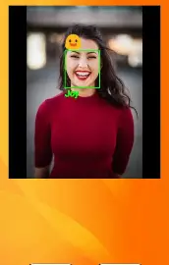
Concept
An App that uses AI to detect emotions and plays a song after.

Slide 3

Timeline
Sept 2025
Idea formed, initial research of AI models
Oct 2025
Learned OpenCV, webcam setup
Nov 2025
First working emotion detection
Dec 2025
Prototype cleanup and demo prep

Slide 4
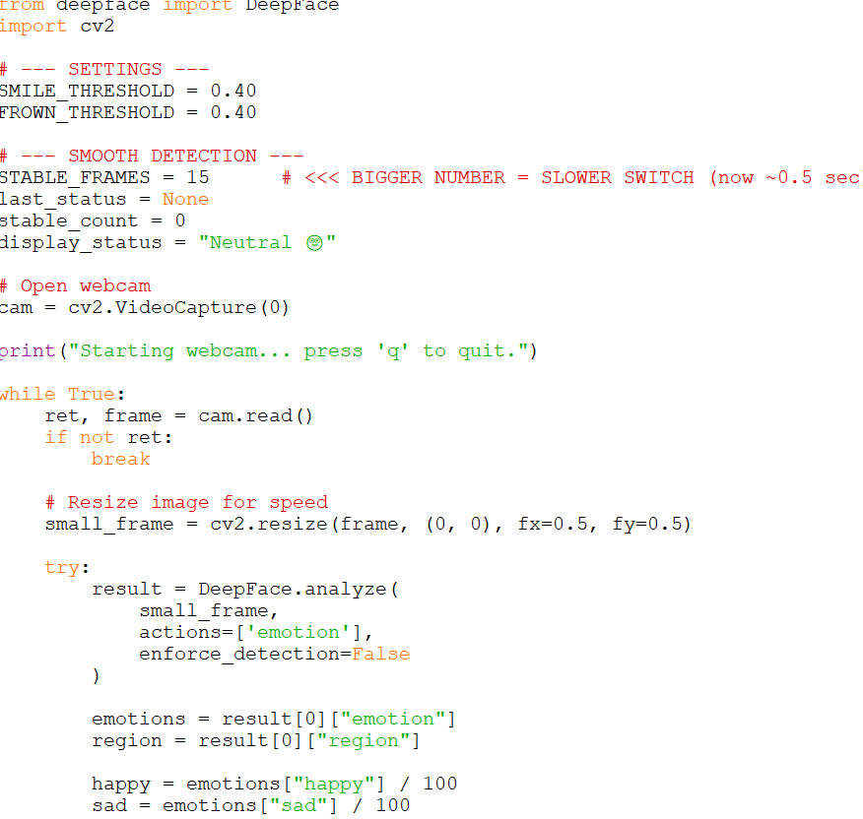
Python
Python
Main programming language
Handles app logic and flow
Connects OpenCV and DeepFace
Controls emotion output and music logic ( OpenCV and DeepFace use python)

Slide 5
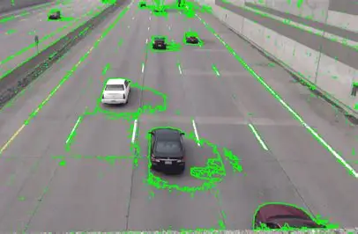
OpenCV
Open-source computer vision library
Turns on and reads the laptop webcam
Processes video frame by frame
Detects faces in real time

Slide 6
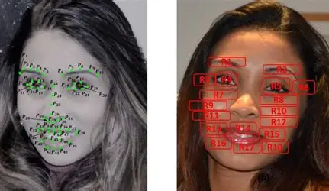
DeepFace
OpenCV handles the camera and finds faces
DeepFace analyzes the face and predicts emotion
In Vibee:
OpenCV = seeing the face
DeepFace = understanding the expression

Slide 7
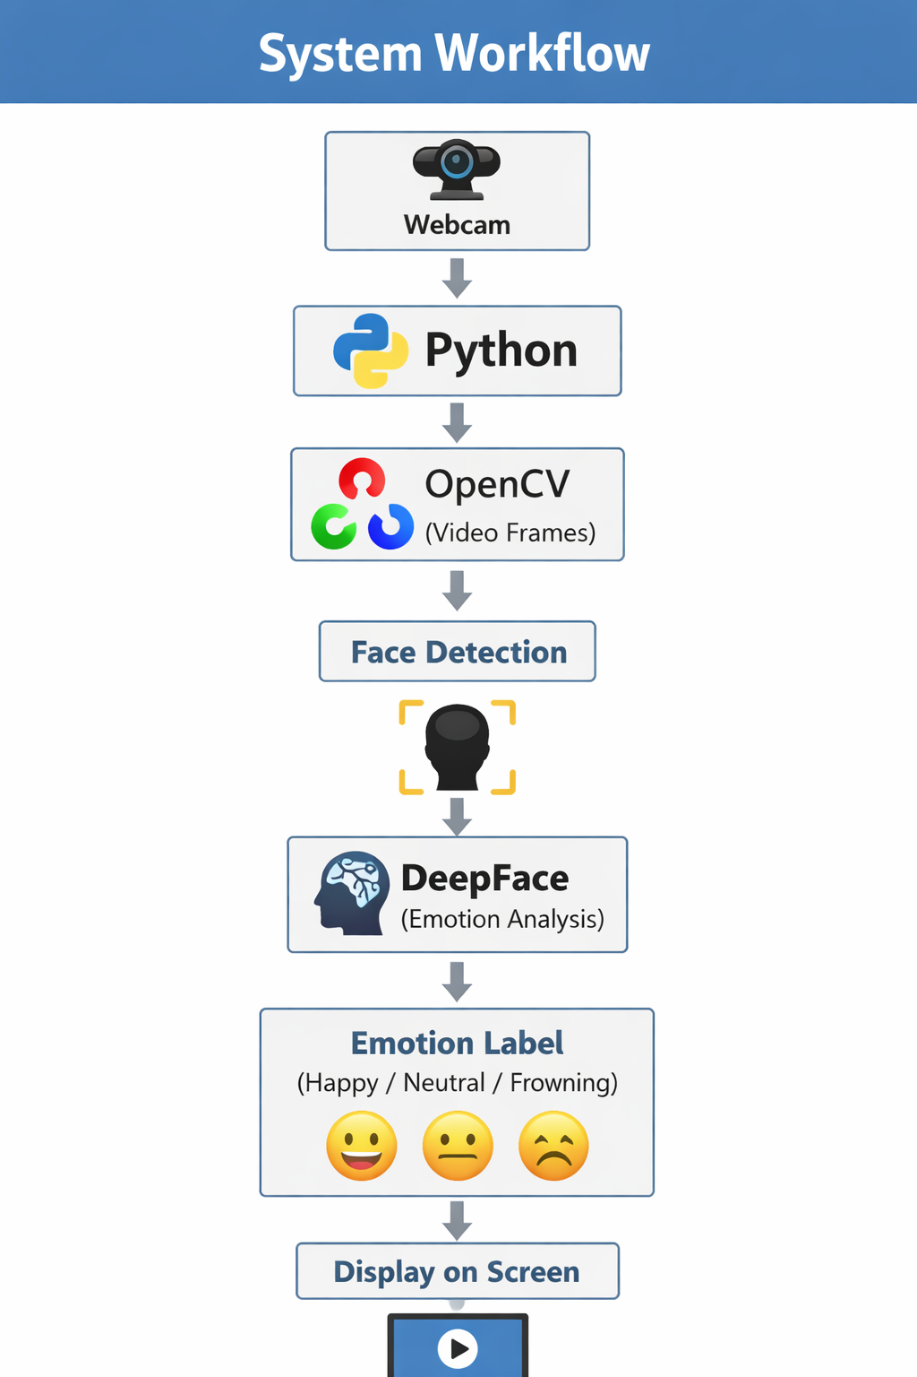
Prototype System Workflow

Slide 8
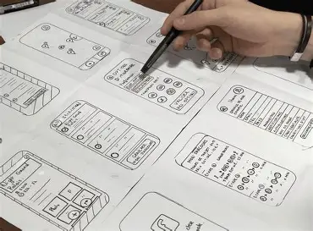
2026 Semester Timeline
Jan–May 2026
Jan–Feb
Plan features, research emotion + music
March
Add music playback,
April
UI improvements, testing, research mobile version implementation
May
Polish and demo prep

Slide 9
Work Cited
OpenCV Official Docs — Tutorials (Python) — main OpenCV-Python tutorial hub (video capture, GUI, image processing).
https://docs.opencv.org/4.x/d6/d00/tutorial_py_root.html
OpenCV DNN-based face detection guide (official) — OpenCV tutorial covering the DNN face detector and the cv::dnn models.
https://docs.opencv.org/4.x/d0/dd4/tutorial_dnn_face.html
OpenCV - Getting Started with Videos — how to access webcam (cv.VideoCapture) and process video frames.
https://docs.opencv.org/4.x/dd/d43/tutorial_py_video_display.html
OpenCV-Python Tutorials (root) — complete API and module reference for Python users.
https://docs.opencv.org/4.x/
Python code assistance by OpenCV and DeepFace Documents, and
provided by ChatGPT, Used for troubleshooting, structure, and iteration. Final implementation reviewed and modified by me

